Slide 1
API and Python training
Session 7

Slide 2
This session agenda
Recap from last session
Classes and objects in real life
Classes and objects in Python
Constructors
Class methods
Class variables
Object-oriented programming concepts
Object-oriented programming example
Demo

Slide 3
Recap from Session 6 (Demo)

Slide 4
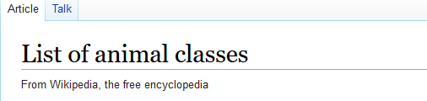



Classes and objects in real life
There are many ‘things’ around us and people use classification to group these things
These things are logically grouped together using some common properties
For example, animals are grouped into classes based on a few common traits.
If you come across an animal you don’t know yet, but you know it’s a mammal, you can already assume it can produce milk and has fur
A Class itself is a definition – describes what properties its instances have
A Class Instance or Object is a real ‘thing’ which belongs to a particular class. We set some values to the properties thus fully describing the object
Your cat is an object with some values assigned to its properties – property colour, value = black; name, number of legs (with default value of four for mammals)
My cat is a different object with different properties, so different colour, name, potentially different number of legs (but not more than four)
These are two different objects of the same class
Not only these objects have some common traits, but they do the same actions – they can run, but can’t fly
We define in classes not only properties, but also possible actions
https://en.wikipedia.org/wiki/List_of_animal_classes
Two instances of class mammals with different properties:

Slide 5

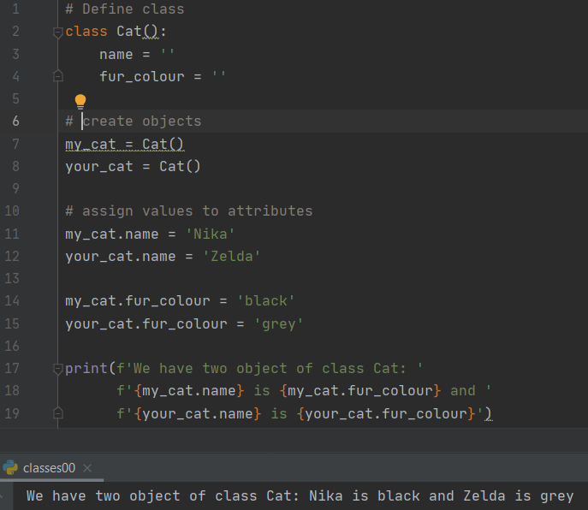
Classes and objects in Python
To define a class use syntax:
class <class_name>:
<block of code>
Naming convention for class names is upper camel case:
ResponseReceived , FirewallZones, etc
The block of code within the class has indentation to define where the class starts and ends
Similar to variables in functions, you can/define variables within the class – these are called class attributes (or class properties)
To create a new object (also called class instance) of a particular class, use syntax
<variable> = <ClassName>()
Then you work with different objects using their variable names/IDs
To set or get object attribute use <obj_variable>.<attribute>
https://en.wikipedia.org/wiki/Camel_case

Slide 6
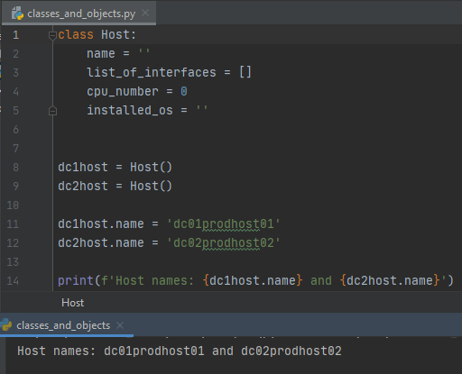
Classes and objects - definitions
We group anything into classes, define properties (class attributes or class properties) and actions which a ‘thing’ can do or can be done on it (class methods)
Class attributes are variables, class methods are functions
Example of classes – definition of ‘things’:
Class router:
Attributes – hostname, mgmt. IP, list of interfaces, list of routes, etc.
Methods – shutdown interface,
assign IP to interface (change attribute),
send routing update (request to change other
object’s attribute)
Class host:
Attributes – hostname, amount of RAM, CPU, disk, HDD, OS
Methods – attach disk, install new OS
Objects = class instances
Define objects - real routers:
Object id - host1 Attributes – dc01prod01, 8, 4, 200, linux
Object id – host2 Attributes – dc01prod02, 16, 16, 100, windows
Then we can change properties of these objects separately
and independently from any other objects

Slide 7
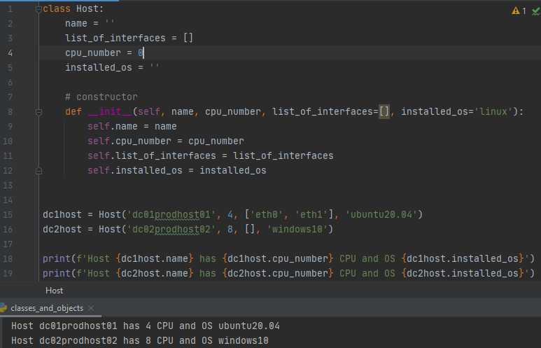
Constructors
Often, instead of creating a new object and assigning some values later, it’s convenient to define some attributes at the same time we create an object
To set these initial values (or do some initial actions) use special function called constructor – this function will be executed automatically every time you create a new object
Syntax:
class <name>:
def __init__(self, <parameters>):
<block of code>
__init__ is a reserved name of function-constructor
Note the first argument of any class function is always self
The rest of arguments are normal arguments similar in all other Python functions
To access class variables within the constructor, use self.<variable_name> See Lines 9-12 ------------------>
Once you defined a constructor, you can pass parameters to the constructor function and set object’s attributes using these parameters - Lines 15 and 16 -------->
https://www.geeksforgeeks.org/self-in-python-class/

Slide 8
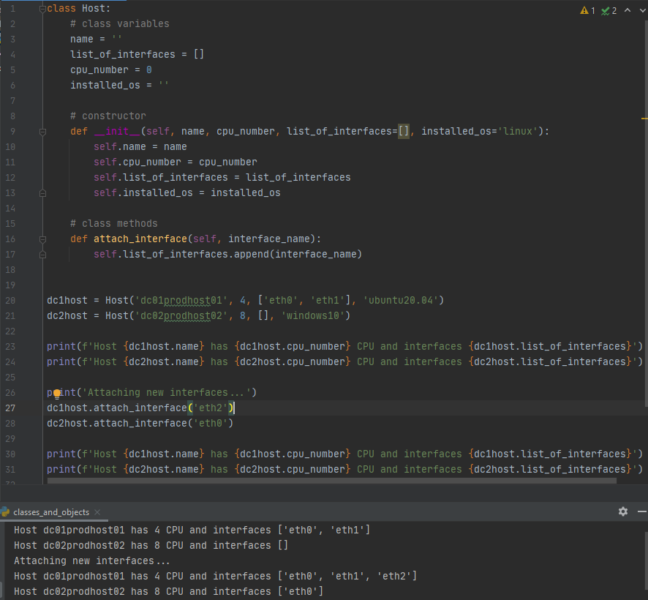
Class methods
Class methods are functions defined within the class, constructor is one of them
The same syntax as all other functions
The first argument is always self
The class method can access class variables using syntax self.<attribute>
Once we have created an object, we can use its methods, so class methods become object’s methods (what this object can do)
To call object’s methods, syntax is the same as we access class variables, so <object>.<method>
Note in the example - Even though we use the same method (attach_interface), we work with different objects, so we change attributes of each object independently

Slide 9
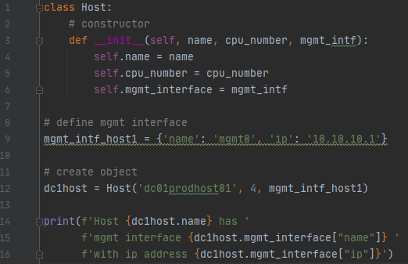
Class variables
Not necessary to define all variables on the class level
The common practice is to define and initialise them
in the constructor
In the example below we introduce a new class variable – mgmt_interface type dictionary, but there might be a better way using object-oriented approach (next slides)

Slide 10
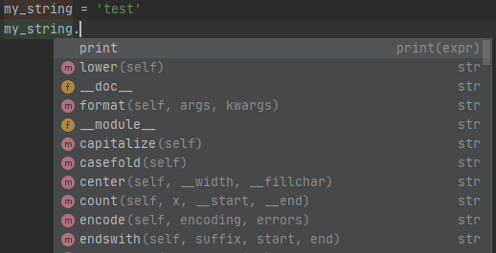
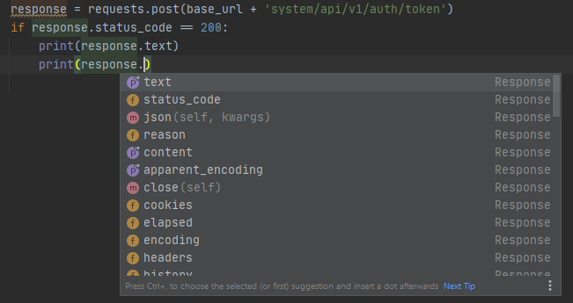
Object-oriented programming
Treat ‘things’ you work with, as class instances: define a class with attributes and methods, create an object and work with the objects
All variables (and even functions) in Python are objects, so we can use their attributes and methods
This approach is called Object-oriented programming (OOP)
IDE can list available methods and attributes for an object:
https://en.wikipedia.org/wiki/Object-oriented_programming

Slide 11
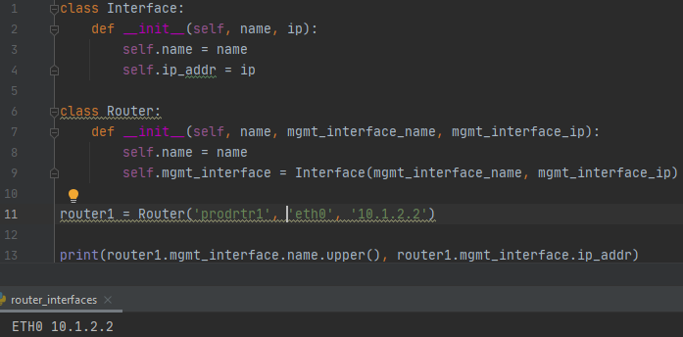
Object-oriented programming - example
Represent ‘things’ as classes with attributes
A class can have a variable of another class
To access these nested class variables or methods, use <object>.<object>.attribute<etc>
Example
Line 9 – mgmt_interface of class Router is a class instance of Interface
Line 13 – we can get Interface name using the following construct:
In this example we could have defined mgmt_interface as a dictionary
Use class instances where they fit logically, this depends on the design of your application
In Python 3.8 there is a special class type – data class
router1.mgmt_interface.name.upper()
^^^ ^^^ ^^^ ^^^^
Variable Variable Variable Method – note ()
of class Router of class Interface of class string of class string
https://realpython.com/python-data-classes/

Slide 12
Demo

Slide 13
Summary and next steps
Summary
Classes
Class instances – Objects
Class properties/attributes
Class methods
OOP – Object-oriented programming
Next time
SDKs – what are they, how to use them
Building your own API server – intro to Flask

